Slide 1
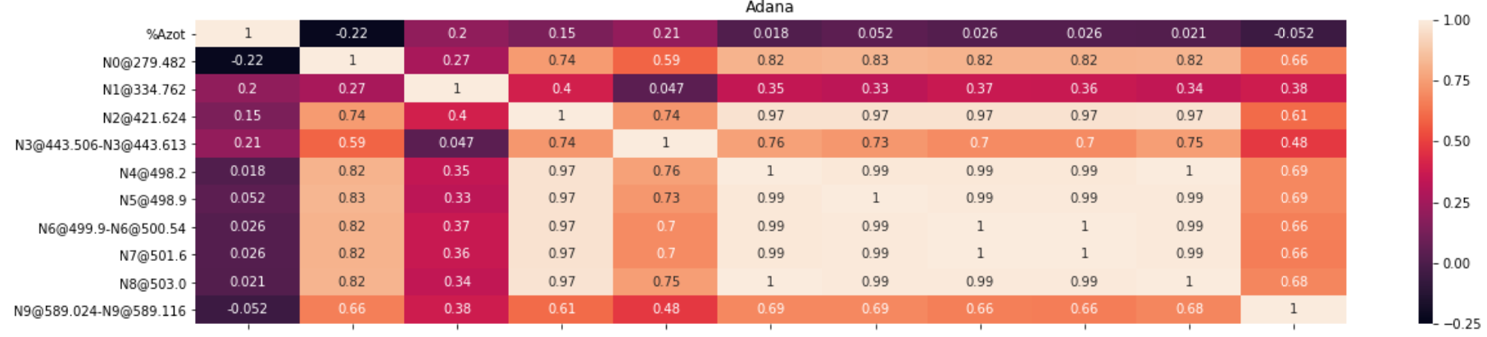
Correlation Matrix - Adana

Slide 2
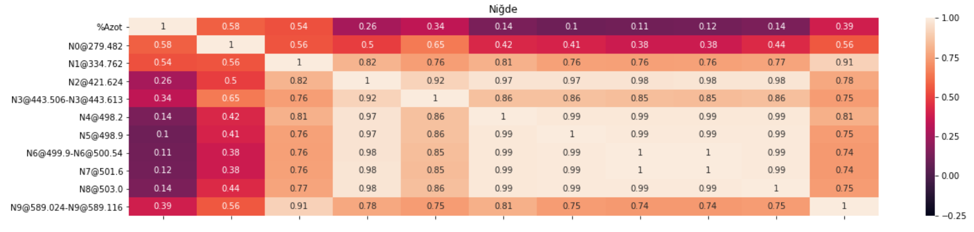
Correlation Matrix - Nigde

Slide 3
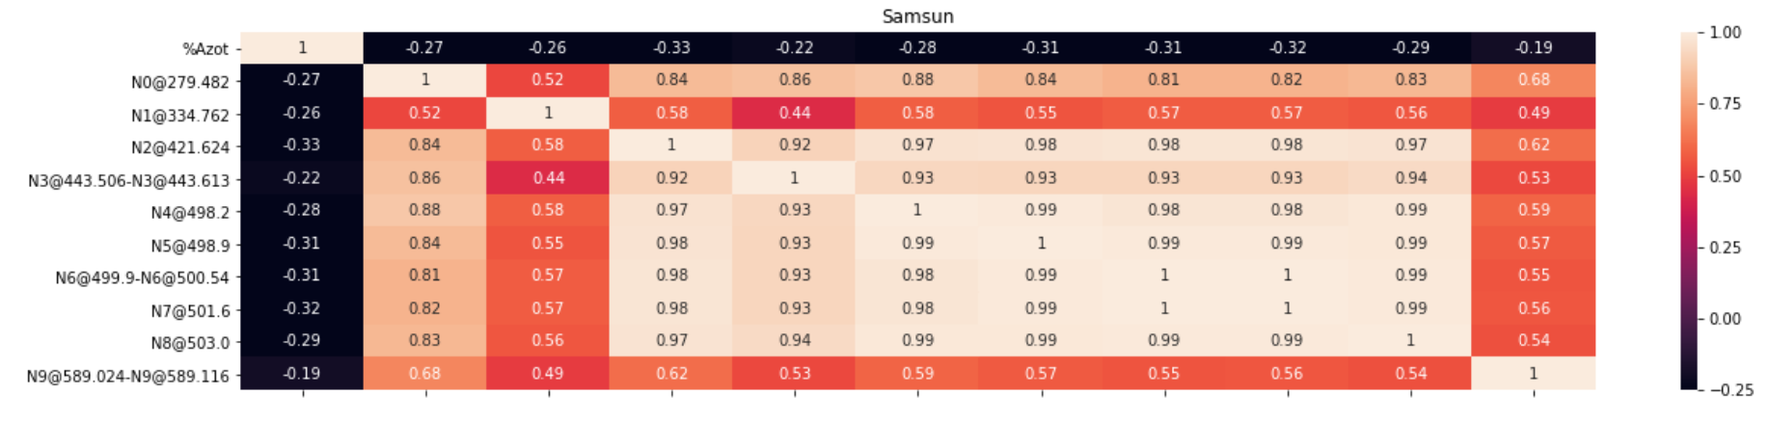
Correlation Matrix - Samsun

Slide 4
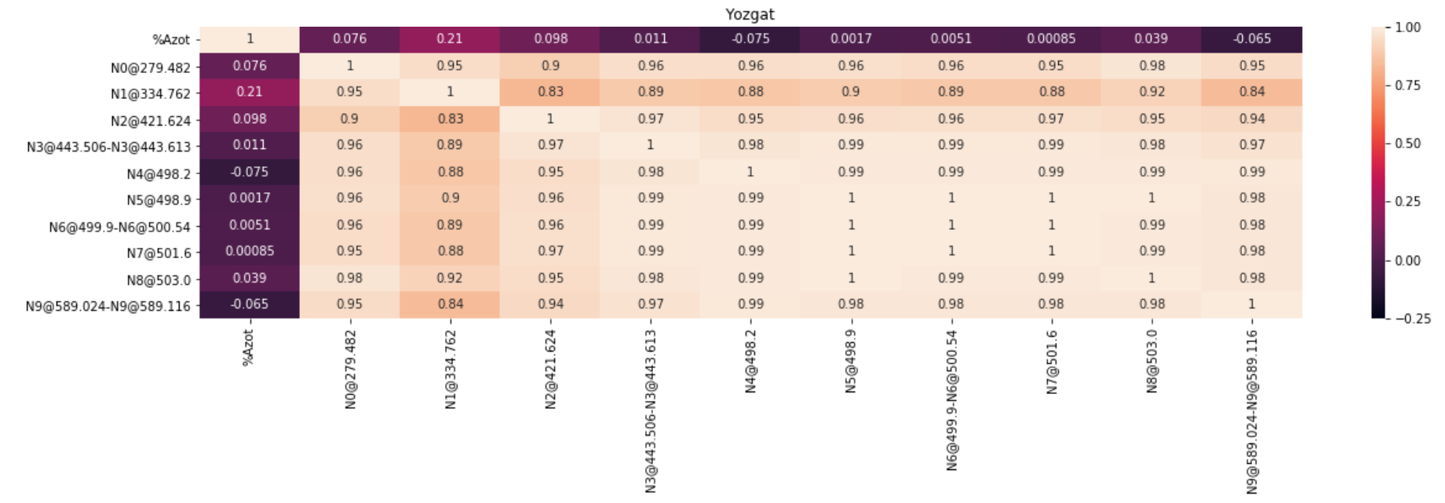
Correlation Matrix - Yozgat

Slide 5
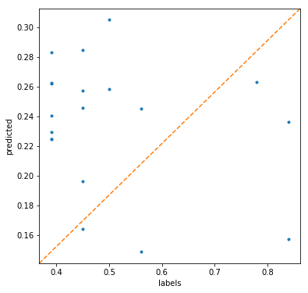
Decision Tree Regressor

Slide 6
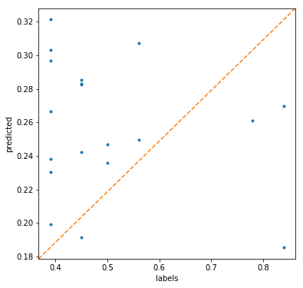
Linear Regression

